Slide 1
Daily Scrum
08/07
Da Ye Lee Java A-4 SK Didimdol 4th hillofsky@naver.com

Slide 2
Task List
Assigned Task | Progress
UI 구현(JSP, CSS) | 90%
Oracle DB 연동 | 0%
페이지 상세 구현 | 0%

Slide 3
Yesterday’s Task
Today’s Task
Technical Issue

Slide 4
1. Yesterday’s Task
What I did?
UI 구현(JSP, CSS)
예약 리스트 페이지 구현 (reservationList.jsp)
예약 수정 페이지 구현 (updateReservation.jsp)

Slide 5
1. Yesterday’s Task
How I did?
UI 구현(JSP, CSS)
airDnDCSS.css에서 필요한 css 추가
reservationList.jsp와 updateReservation.jsp 구현

Slide 6
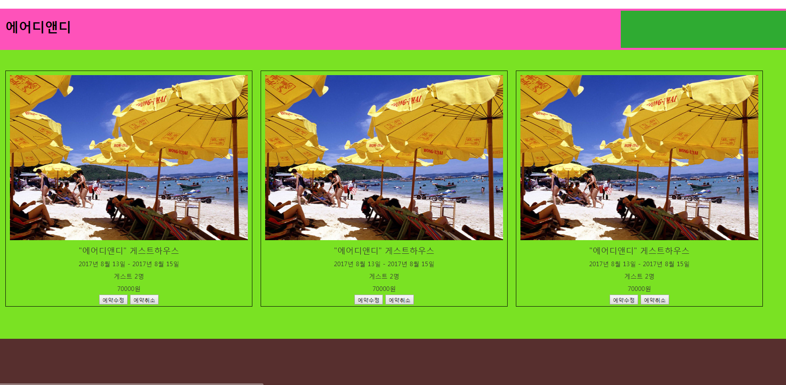
1. Yesterday’s Task
Result
UI Design

Slide 7
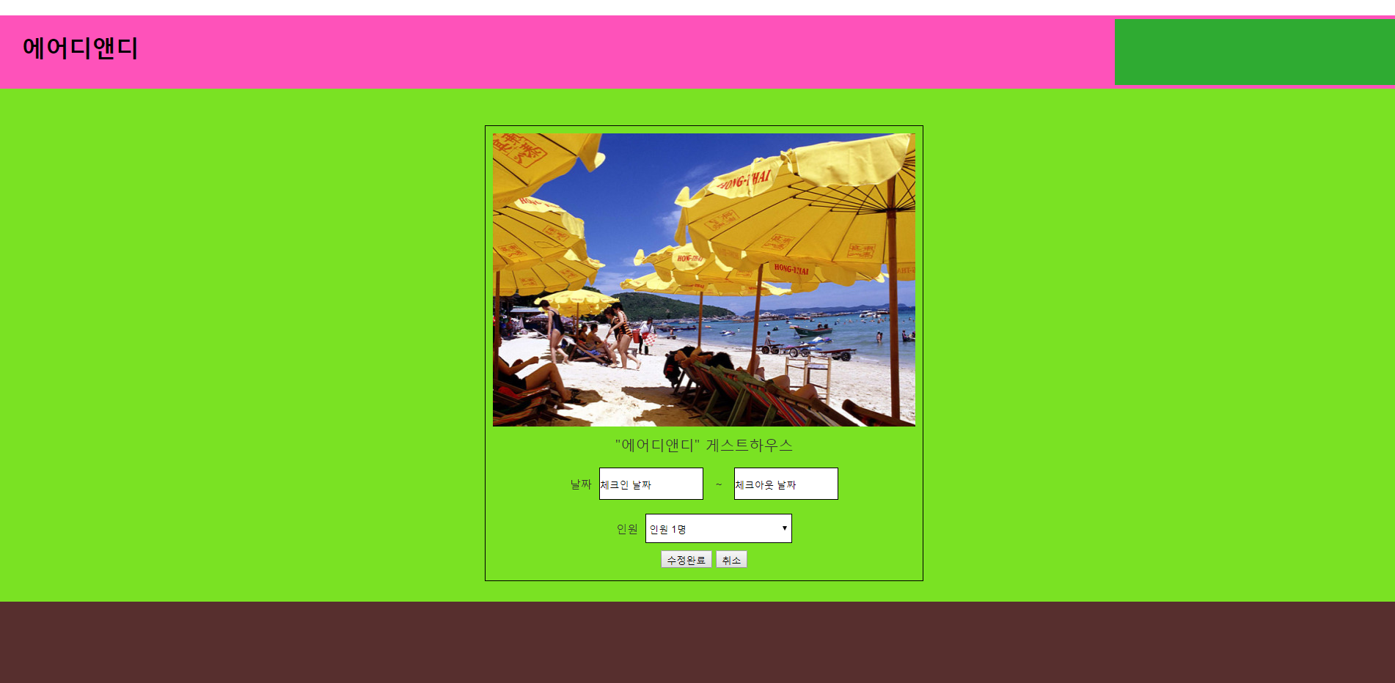
1. Yesterday’s Task
Result
UI Design

Slide 8
Yesterday’s Task
Today’s Task
Technical Issue

Slide 9
2. Today’s Task
ToDo
Oracle 설치 및 연동

Slide 10
Yesterday’s Task
Today’s Task
Technical Issue

Slide 11
3. Technical Issue
Issue
없음

Slide 12
END

